Slide 1
Data structures and algorithm
Dr. Seemab Latif
Lecture No. 5
13th October, 2010

Slide 2
Stacks
A stack is a list in which insertion and deletion take place at the same end
This end is called top
The other end is called bottom
Stacks are known as LIFO (Last In, First Out) lists.
The last element inserted will be the first to be retrieved
E.g. a stack of Plates, books, boxes etc.

Slide 3
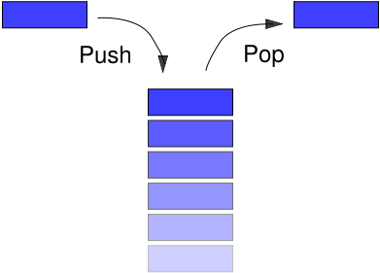
Insertion and deletion on stack

Slide 4
Operation On Stack
Creating a stack
Checking stack---- either empty or full
Insert (PUSH) an element in the stack
Delete (POP) an element from the stack
Access the top element
Display the elements of stack

Slide 5
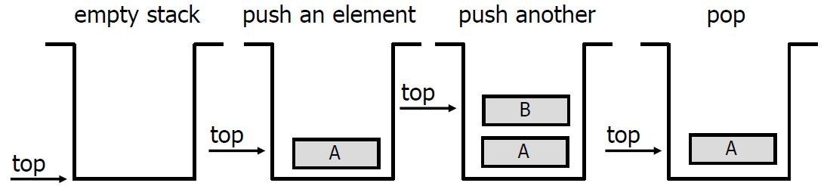
Push and Pop
Primary operations: Push and Pop
Push
Add an element to the top of the stack.
Pop
Remove the element at the top of the stack.

Slide 6
Stack-Related Terms
Top
A pointer that points the top element in the stack.
Stack Underflow
When there is no element in the stack or stack holds elements less than its capacity, the status of stack is known as stack underflow.
Stack Overflow
When the stack contains equal number of elements as per its capacity and no more elements can be added, the status of stack is known as stack overflow

Slide 7
Stack Implementation
Implementation can be done in two ways
Static implementation
Dynamic Implementation
Static Implementation
Stacks have fixed size, and are implemented as arrays
It is also inefficient for utilization of memory
Dynamic Implementation
Stack grow in size as needed, and implemented as linked lists
Dynamic Implementation is done through pointers
The memory is efficiently utilize with Dynamic Implementations

Slide 8
Static Implementation
Elements are stored in contiguous cells of an array.
New elements can be inserted to the top of the list.
top
First Element
Second Element
List
Last Element
Empty
maxlength

Slide 9
Static Implementation
Every PUSH and POP requires moving the entire array up and down.
1
2
3

Slide 10
Static Implementation
Since, in a stack the insertion and deletion take place only at the top, so…
A better Implementation:
Anchor the bottom of the stack at the bottom of the array
Let the stack grow towards the top of the array
Top indicates the current position of the first stack element.

Slide 11
Static Implementation: A better Implementation
top
1
2
First Element
Second Element
.
.
maxlength
Last Element

Slide 12
A Simple Stack Class
class IntStack{
private:
int *stackArray;
int stackSize;
int top;
public:
IntStack(int);
bool isEmpty();
bool isFull();
void push();
void pop();
void displayStack();
void displayTopElement();
};

Slide 13
Constructor
IntStack::IntStack(int size)
{
stackArray = new int[size];
stackSize = size;
top = -1;
}

Slide 14
Push( )
void IntStack::push()
{
clrscr();
int num;
if(top>=stackSize)
cout<<"stack Overflow"<<endl;
else
{
cout<<"Enter Number=";
cin>>num;
top++;
stackArray[top]=num;
}
}

Slide 15
Pop( )
void IntStack::pop()
{
clrscr();
if(top == -1)
cout<<"Stack Underflow"<<endl;
else
{
cout<<"Number Deleted From the stack=";
cout<<stackArray[top];
top--;
}
getche();
}

Slide 16
Main( )
void main ()
{
IntStack stack(5);
int choice;
do
{
cout<<“Menu"<<endl;
cout<<"1-- PUSH"<<endl;
cout<<"2-- POP"<<endl;
cout<<"3– DISPLAY "<<endl;
cout<<"4-- Exit"<<endl;
cout<<"Enter choice=";
cin>>choice;
switch(choice)
{
case 1:
stack.push(); break;
case 2:
stack.pop(); break;
case 3:
stack.displayStack();
break;
}
}while(choice!=4);
getche();
}

Slide 17
Dynamic Implementation of Stacks
As we know that dynamic stack is implemented using linked-list.
In dynamic implementation stack can expand or shrink with each PUSH or POP operation.
PUSH and POP operate only on the first/top cell on the list.
Top
x
y
NULL
z

Slide 18
Dynamic Implementation of Stack
Class Definition
class ListStack{
private:
struct node{
int num;
node *next;
}*top;
public:
ListStack(){ top=NULL;}
void push();
void pop();
void display();
};

Slide 19
Push( ) Function
This function creates a new node and ask the user to enter the data to be saved on the newly created node.
void ListStack::push()
{
node *newNode;
newNode= new node;
cout<<“Enter number to add on stack";
cin>> newNode->num;
newNode->next=top;
top=newNode;
}

Slide 20
Pop( ) Function
void ListStack::pop()
{
node *temp;
temp=top;
if(top==NULL)
cout<<"Stack UnderFlow"<<endl;
else
{
cout<<"deleted Number from the stack =";
cout<<top->num;
top=top->next;
delete temp;
}
}

Slide 21
Main( ) Function
void main()
{
clrscr();
ListStack LS;
int choice;
do{
cout<<"Menu "<<endl;
cout<<"1.Push" <<endl;
cout<<"2.Pop"<<endl;
cout<<"3.Show"<<endl;
cout<<"4.EXIT"<<endl;
cin>>choice;
switch(choice){
case 1:
LS.push();
break;
case 2:
LS.pop();
break;
case 3: LS.display();
break;
}
}while(choice!=4);
}

Slide 22
Stack applications
“Back” button of Web Browser
History of visited web pages is pushed onto the stack and popped when “back” button is clicked
“Undo” functionality of a text editor
Reversing the order of elements in an array
Saving local variables when one function calls another, and this one calls another, and so on.

Slide 23
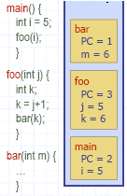
C++ Run-time Stack
The C++ run-time system keeps track of the chain of active functions with a stack
When a function is called, the run-time system pushes on the stack a frame containing
Local variables and return value
Program counter, keeping track of the statement being executed
When a function returns, its frame is popped from the stack and control is passed to the method on top of the stack

